Slide 1
Simplifying Private Connectivity
SERVICE PROVIDERS
Instant, programmable private connectivity anywhere.
May 2026
Notes:
Leading Questions:
How much engineering effort does it require to provision a new customer circuit?
How do you connect outside your footprint today?
How painful are NNIs across providers and cloud connectivity?
Are customers starting to ask for cloud connectivity services or AI infrastructure access? How are you handling those requests today?

Slide 2

Instant Private Connectivity, Anywhere.
OUR VISION
Programmable private paths — instant network fabric.
Notes:
Our Vision: Instant Private Connectivity, Anywhere
From under-utilized fiber to programmable private paths. Build your own network fabric instantly.
Private connectivity, ready to sell, ready to scale.
That’s our vision.
For operators, this means: no waiting on builds, no new routing protocols, and instant monetization of the network you already own. For end customers, it’s the first time private connectivity feels like cloud — on-demand, API-driven, consumption-based.
Technical simplicity is economic opportunity.
When connecting sites becomes push-button easy, fiber finally behaves like a digital asset, not real estate.

Slide 3




3 Decades of Connecting Networks
The Team
Acme Packet
Invented Session Border Controller. Founded in 2000. Acquired by Oracle in 2013.
Cisco
Led MPLS Architecture team.
128 Technology
Invented Secure Vector Routing. Founded in 2014. Acquired by Juniper Networks in 2020.
ABILASH MENON
CEO & Co-Founder
TIM ZIEMER
CRO & Co-Founder
ANDY ORY
Executive Chairman
PATRICK MELAMPY
CFO & Board Member
Juniper Networks
Integrated SD-WAN technology as the routing engine for Mist AI.
Cisco, 128 Technology, Juniper
Acme Packet, Oracle
128 Technology, Juniper
Acme Packet, Oracle
128 Technology, Juniper
Acme Packet, Oracle
128 Technology, Juniper
Notes:
Our leadership team has been doing this for decades. Our mission across mulitiple companies has been the same – simplifying network connectivity.
Acme Packet — Voice was fragmented across incompatible networks. The SBC became the standard bridging layer. It's still running in 90% of global carriers today.
Cisco – transformational in MPLS architecture, our CEO led that team
128 Technology — IP routing was expensive, rigid, and hard to manage at scale. Secure Vector Routing (SD-WAN) simplified it. 128T was Juniper's largest acquisition.
Juniper and Mist Systems – AIOps
MaiaEdge — Private Ethernet connectivity is fragmented, static, and manually provisioned. Same problem, next evolution in networking.
Timeline
Andy and Pat Founded Acme Packet in 2000
Invested the Session Border Controller, for connecting VoIP, Technology today is used by 90% of the global 100 Carriers and largest Enterprises
Went Public in 2006 and was acquired by Oracle in 2013 for $2B
Andy and Pat founded 128 Technology 2014
Acquired by Juniper in 2020 as the routing engine for Mist in the AI-Driven enterprise business unit. Juniper’s largest acquisition.
Same team started MaiaEdge in 2024.
People have come out of retirement for MaiaEdge because they believe in the leadership and the product.

Slide 4

Ethernet Islands
Complex Interconnecting Ethernet islands requires complex provisioning.
Manual NNIs require months-long provisioning cycles, manual LOA & complex configurations that don’t scale. Inflexible.
Blind Visibility, performance control, and automation end at your network edge.
Ethernet
2
Ethernet
3
Ethernet
1
Ethernet
6
Ethernet
4
Ethernet
5
$
$
Meet-me Room
Notes:
How do you make networks with different operators, technology, and underlays talk to each other?
The problem here is two-layered
Layer 1 — Internal fragmentation: Most SPs have built or acquired fiber across multiple geographies over time. Each geography became its own Ethernet island — separate equipment, separate management, static provisioning. Connecting those islands means expensive routing and switching infrastructure at every aggregation point. Every new customer path that crosses two islands is a manual engineering project. It doesn't scale.
A good way to make this concrete: think of an SP that has fiber rings in several markets. At each aggregation point, there's a router and switch stack to bridge the islands. When a customer needs connectivity that spans two of those markets, someone has to manually configure both ends. Change the circuit, do it again. That model works when you have 50 customers. It breaks when you're trying to grow.
Layer 2 — Cross-provider NNIs: When a customer needs to reach a site on another carrier's network, the problem compounds. NNIs take months to establish, require coordination between two engineering teams, and once built, are static. There's no way to adapt without starting the process over.
The punchline: this isn't a capacity problem — most SPs have more fiber than they're actively monetizing. It's a provisioning and automation problem.

Slide 5
Connected but not Integrated
Integration timelines are unpredictable.
Customers
expect seamless connectivity
from day one.
Ethernet
2
Ethernet
3
Ethernet
1
Ethernet
6
Ethernet
4
Ethernet
5
$
$
Meet-me Room
Notes:
This slide is specific to companies that are going through M&A
If the company isn’t recently acquired/recently acquired a company, you can skip to the next slide.
When two service providers merge, the assumption is the combined network becomes an asset. The reality is integration takes 12–24 months, requires custom engineering on both sides, and the customer experience suffers in the meantime. Customers who were promised seamless connectivity on day one are still waiting, while your teams are stuck doing manual configs across heterogeneous environments.
Acquired Company Integration:
The Reality: Integration timelines are unpredictable:
Different engineering teams and toolsets
No shared vendor stack or operational processes
Manual configurations across heterogeneous environments
Result: months of manual work before any automation is possible
Cross‑domain requests require coordination between teams
Configuration errors delay service delivery
No unified visibility or control until full integration
Meanwhile, customers expect seamless connectivity from day one.

Slide 6
The Challenge with NaaS
Reach Many can’t reach these fabrics easily.
Control Lose full ownership of the customer experience.
Cost & Complexity Cloud connectivity still requires a virtual router for multi-cloud and expensive long-haul transport.
Ethernet
1
Ethernet
N
$
$
$
$
Centralized NaaS Fabrics
Notes:
Now, Equinix Fabric and Megaport deserve credit. They proved there’s demand for elastic interconnection.
But carriers rarely participate for three reasons:
First — the on-ramp problem. Many simply can’t reach those fabrics easily.
Second — Control. No one wants to hand over the customer relationship to a third party.
Third — complexity. It’s hard to front-end those systems without heavy development.
A new approach to interconnecting Ethernet islands requires:
Automated simplicity
Complete control over the customer relationship
End to end visibility

Slide 7

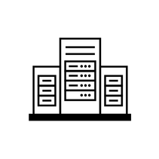


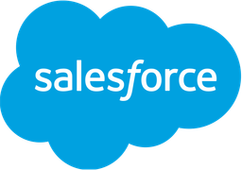
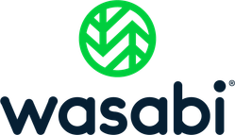
What if connectivity was this simple?
Cloud On-Ramps
MSPs & DCs
Your Network
Private connectivity across any network. Provisioned in minutes without routing complexity.
Enterprises
Marketplace
SaaS + AI + Storage
Programmable private paths — Instant network fabric
Provision Layer 2 Ethernet paths across any network, any transport.
Deterministic connectivity across network boundaries.
End-to-end insights across partner networks, fabrics, and clouds.
Automated
Programmable
Visible
Notes:
What if provisioning private L2 connectivity could be as simple as clicking a button?
What if you could provide connectivity to any site or service your customers needed?
What if you could offer customers private connectivity to Cloud on-ramps, SaaS applications, AI infrastructure instantly?
What if you could do all this, from your network?
Imagine connectivity anywhere, provisioned instantly without any routing complexity. Completely automated, doesn’t matter what underlay who who owns the infrastructure.
A to Z in a click.
Private paths working together to create a private network fabric. No configuration or routing complex. Faster time to market. End to end visibility and control.
This is what MaiaEdge enables.

Slide 8
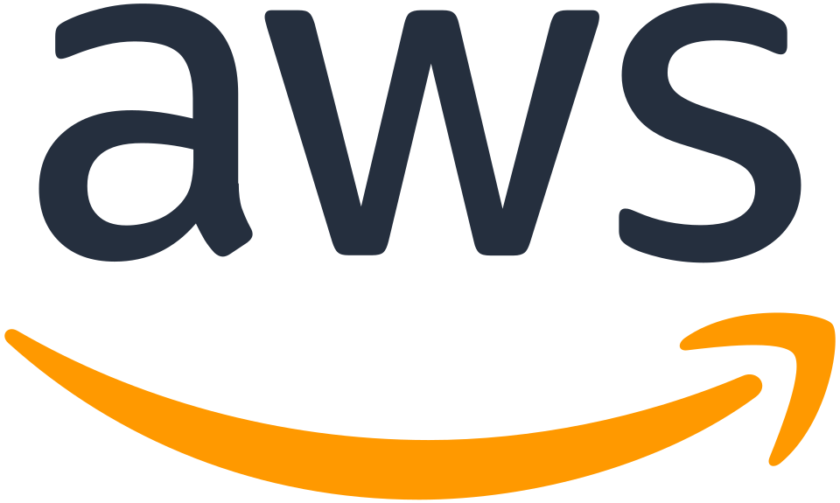
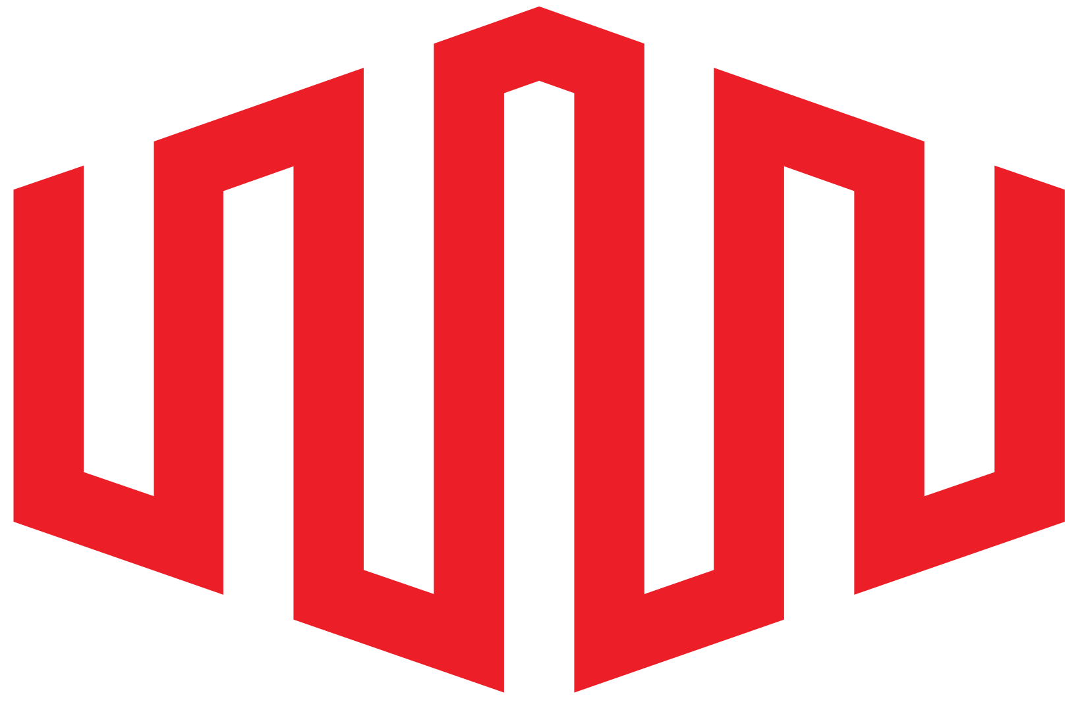


Instant Private Fabric
Programmable Deliver layer 2 Ethernet services instantly over fiber or DIA. No routing complexity.
Federate Reach beyond your network edge. Monetize underutilized capacity.
Control Interconnect with partners, NaaS fabrics, and clouds, while maintaining complete customer ownership.
Ethernet 1
Ethernet
N
DIA
Meet-me Room
8 © 2026 MaiaEdge
Notes:
MaiaEdge fits into your existing network. It sits at the edge and extends what's already there.
Context on each pillar:
Programmable — Layer 2 Ethernet over fiber or DIA. No routing protocols. Drop a device, configure once, and private paths are instantly available to any connected endpoint.
Federate —This is the NNI story. Instead of months of manual coordination and negotiations to set up static connections, MaiaEdge enables you to establish NNIs instantly over fiber or DIA. Partnerships can be established in minutes instead of months so you can reach further and sell spare capacity to other providers.
Control — Connect with partners and to NaaS fabrics like Equinix and Megaport to extend reach and expand service offerings, all while maintaining complete ownership of the customer and gaining end to end visibility and performance control across partner networks.
Key differentiator to emphasize: This isn't a competing NaaS fabric, it's what lets you build your own fabric. Unlike NaaS, which owns their own network, MaiaEdge enalbes providers to build their own network fabric. Providers maintain complete control over customers relationships.
Key Differentiators:
Ethernet over DIA. Provision deterministic L2 private paths over DIA instantly. MaiaEdge is the ONLY solution that makes this possible. For network opetaors this means they can establish connectivity faster and cheaper.
Cloud access. MaiaEdge gives providers who aren’t yet offering cloud access a very simple way to get started OR drastically simplifies it for those already offering it. If this is interesting to the prospect, use the Simplified Cloud Connectivity slides (slides 40-47).
Many providers don’t know how much revenue they are leaving on the table by not offering cloud on-ramp services.

Slide 9
Use Case 1: Verizon Carrier Ethernet extension with CE over Broadband with end-to-end performance guaranteed
Verizon
Customer
CE CPE
Partner MEF 140 CE over Broadband Network
Partner
ONU/OLT
Partner
OLT
PON or DOCSIS
UNI
ENNI
CE Network
[MEF 140] Carrier Ethernet over Broadband
Verizon
Customer
CE CPE
Comcast
ENNI Switch
Verizon
ENNI Switch
Use Case 2: Verizon CE extension over BB without end-to-end performance guaranteed
Partner Broadband Network
Verizon Carrier Ethernet Network
Verizon
Customer
CPE
Partner
IP BB I/F
Partner
IP BB I/F
Broadband
UNI
NNI
CE Network
L2 Tunnel over IP Broadband
Verizon
L2 over BB
Switch
Verizon
Customer
CE CPE

Slide 10
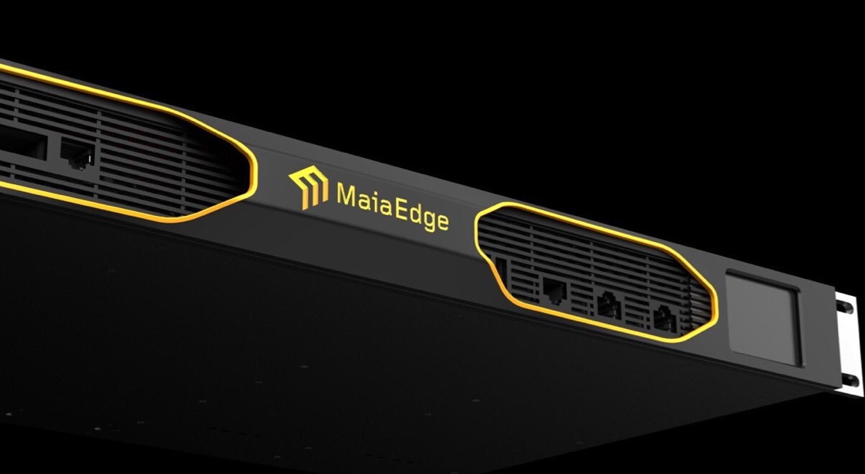
The Infrastructure
Push-button easy and hardwire simple
Path Border Controller (PBC)
Path Computation Engine (PCE)
Private Ethernet paths
End-to-end encryption
Merges Layer 2 and 3 functionality
Dual 100 Gbps Interfaces
1 G device
No routing protocols
Carrier-Neutral NNI Engine
Cloud-Native Orchestration
Real-time Path Computation
Multi-Tenant
Hop-by-hop visibility
Notes:
MaiaEdge allows you to dynamically create and route Ethernet paths end to end over a variety of transports. You could use layer 2 and layer 3 to route between them. Across multiple hops and networks. Router can't do that with BGP, a switch can't do that with P4 programmability. You need packet by packet processing.
Ethernet is scalable and simple.
Proof: AWS and Azure have been using Ethernet inside their network because of it’s simplicity. NVIDIA is moving from Infiniband to Ethernet. Ethernet is king.
We've taken that simplicity and we are bringing it to the WAN .
MaiaEdge has two components working together.
First, the Path Border Controller — a dual-100 Gig appliance that merges Layer 2 and 3 into one stateless edge. It’s hardware-optimized for throughput, encryption, and zero-touch provisioning.
Integrated Switch for additional port capacity.
Second, the Path Computation Engine — our cloud-native orchestration layer. It computes deterministic paths in real time, automates NNIs, and allows carriers to federate while remaining fully sovereign.
Together they form a carrier-neutral NNI engine. No MPLS upgrades. No SRv6. Just plug it in, register it, and deliver private paths instantly — over fiber or DIA.
That’s instant private connectivity.
Plug and play – you don’t have to change your core network

Slide 11

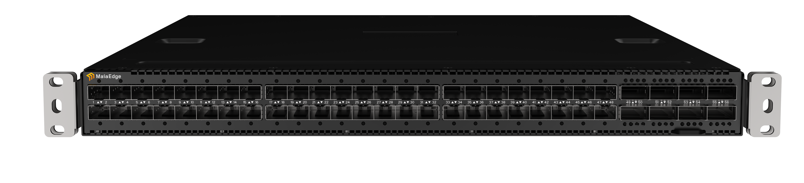
The Infrastructure
Turnkey, plug-and- play switching.
Integrated switch for additional port density
Designed exclusively for the PBC, the integrated switch delivers high-density ports with zero operational overhead.
Port Extender
Interfaces: 48 SFP28 10GbE/25GbE ports, 8 QSFP28
100GbE ports, Rear CPU/BMC shared Ethernet
Management (RJ45) and Serial Console (RJ45) ports,
Latency: Less than 500ns port to port
11 © 2026 MaiaEdge
Notes:
The Port Extender is the integrated switch that sits alongside the PBC to add port density at customer sites. It's not a separate management headache, all managed from the same cloud-native dashboard.
Service providers may or not need the integrated switch.

Slide 12


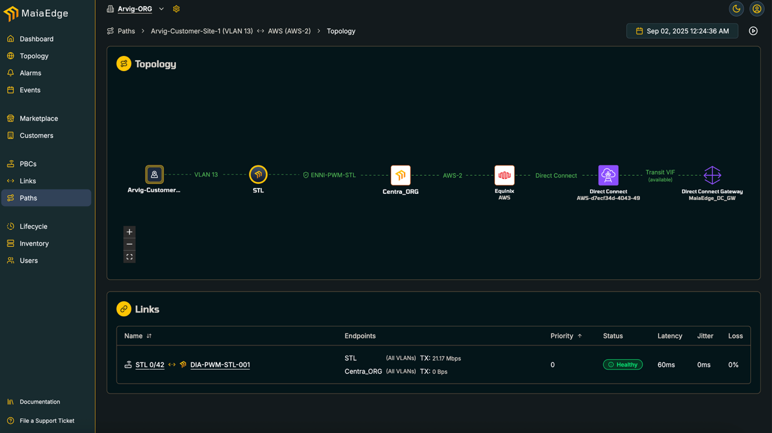
12 © 2026 MaiaEdge
Notes:
One of the things that's fundamentally different about MaiaEdge is that visibility doesn't stop at your network edge. You can see every hop across your network, across partner networks, through a NaaS fabric, and all the way to the cloud on-ramp. No other platform does that today.
When performance degrades, your team knows exactly where the problem is — before the customer calls. You're not waiting for a partner carrier to investigate their segment. You already have the data.

Slide 13
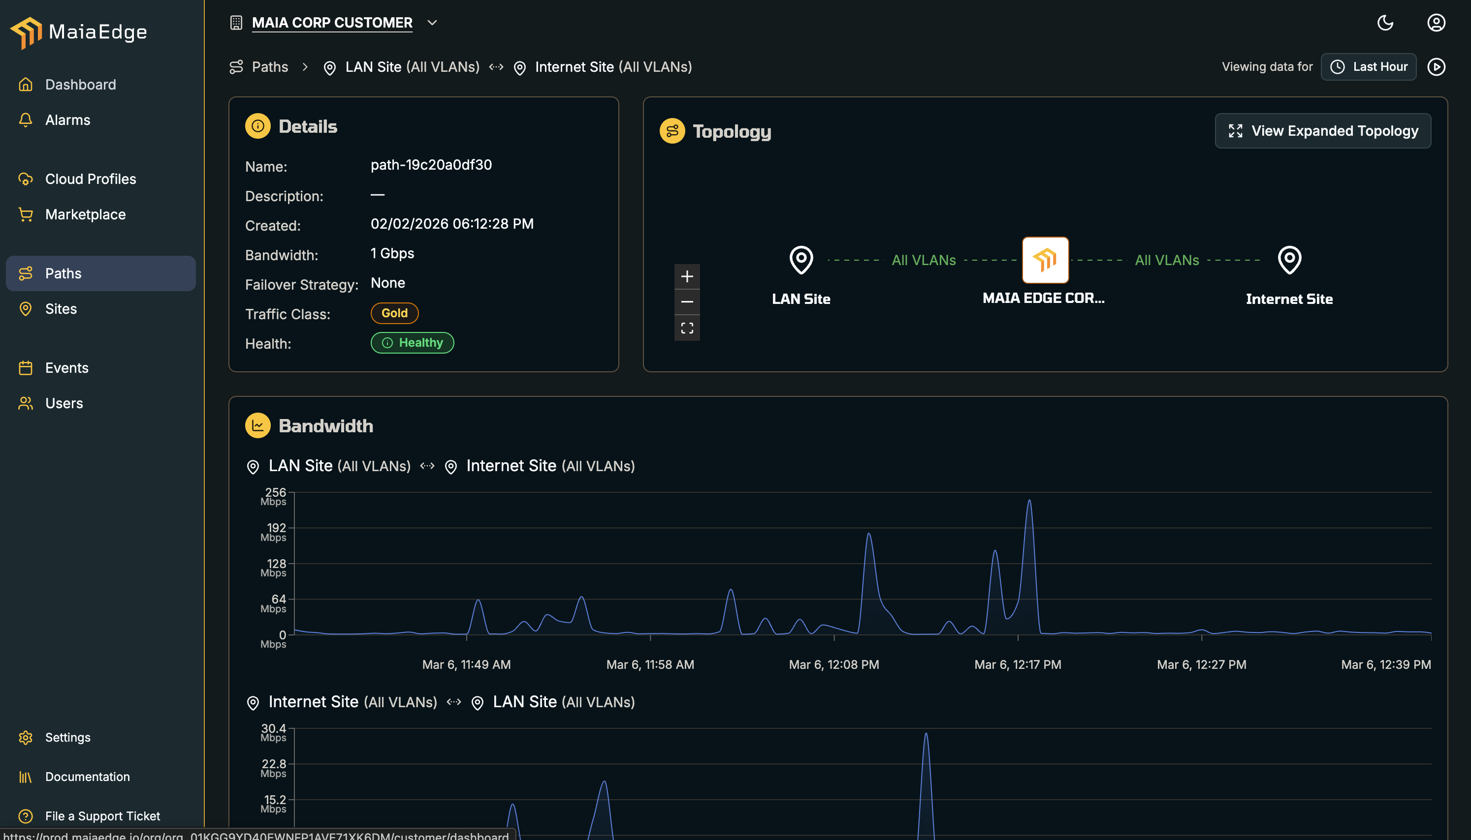
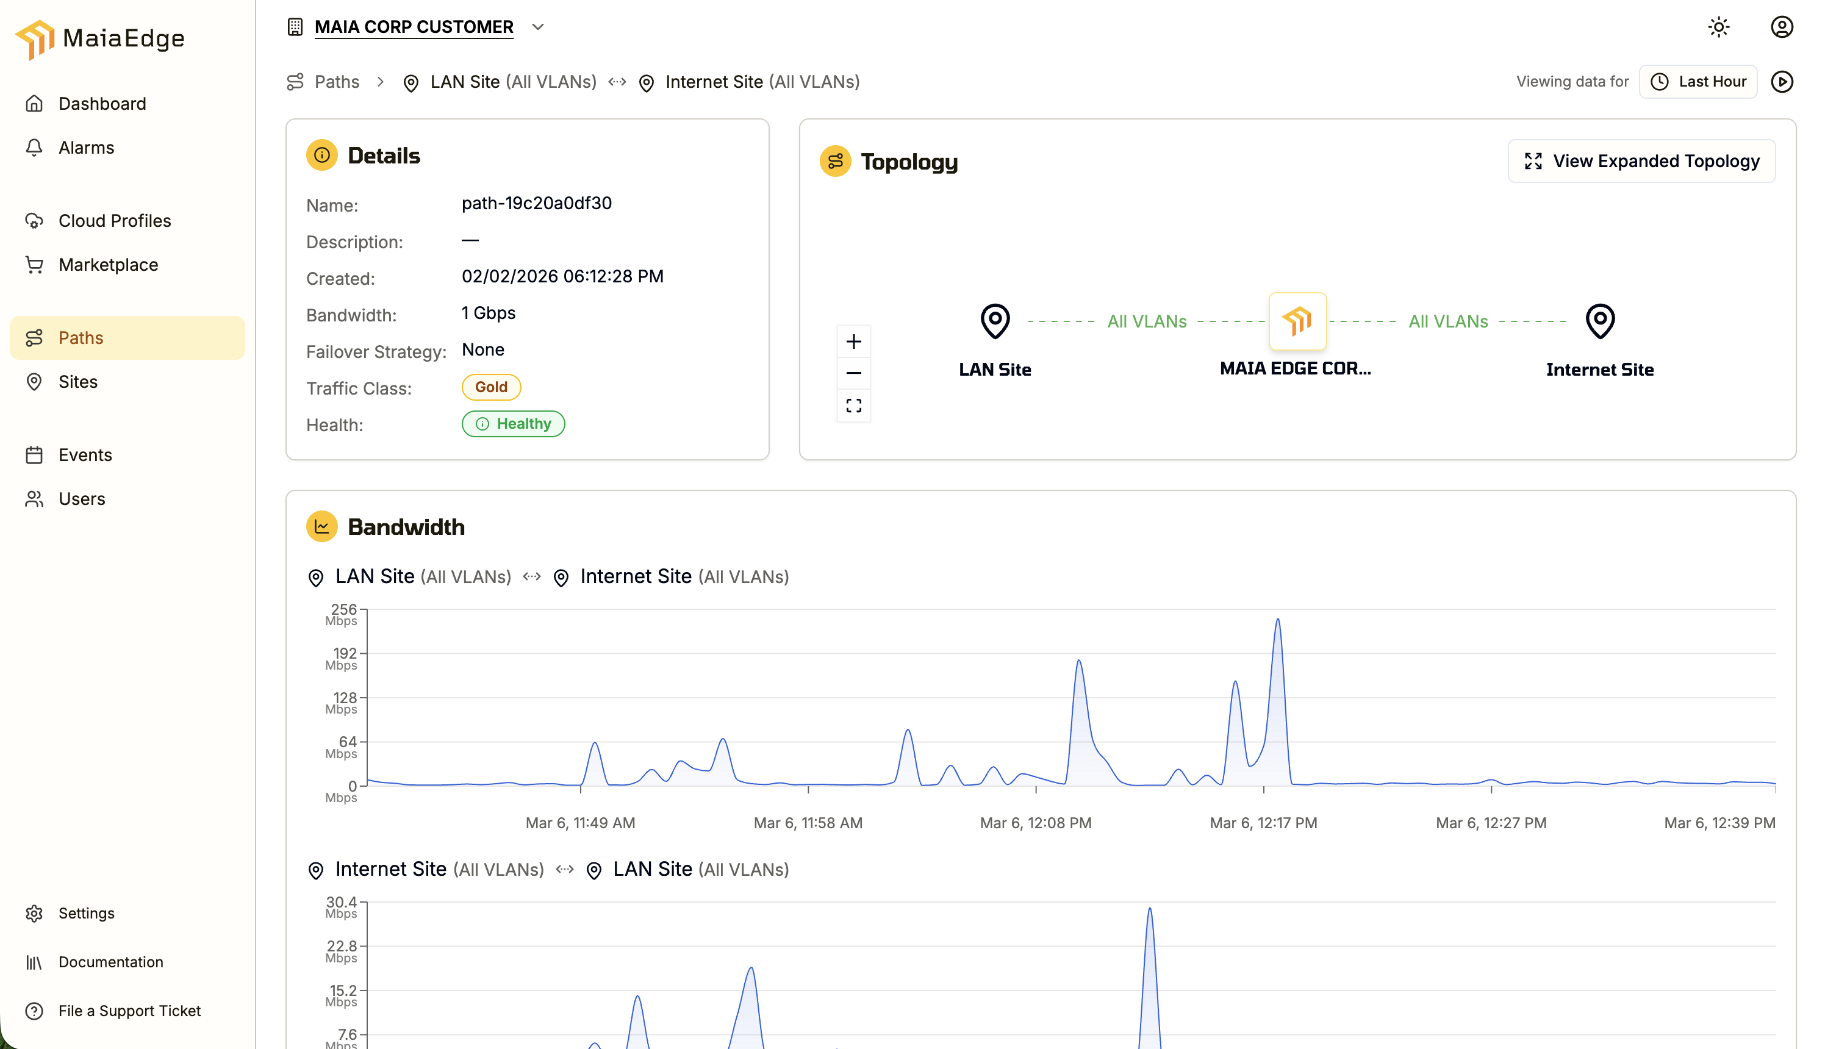
Multi-Tenancy: MSP & Customer View
Network operator view
Customer view (multi-tenancy)
Full topology view
Link capacity & utilization
Complete path health & SLA
Customer self-provisioning
Monitoring and policy control
Private path visibility
13 © 2026 MaiaEdge
Notes:
This slide shows the two sides of the dashboard: the operator's view and the customer's self-service portal.
The operator view gives full topology, link utilization, and path health across every circuit.
The white-label customer portal: Gives customers ability to self-provision new paths and monitor path performance. The customer view is optional to provide to customers.
APIs if provider has their own dashboard, but wants to pull in data.

Slide 14
Connecting Distributed AI
AI INFRASTRUCTURE
Simple, programmable, and sovereign networking for modern AI infrastructure
May 2026
Notes:
How are you connecting AI workloads across sites today?
• How long does it take you to set up connectivity between sites?
• Are your workloads centralized or distributed?
• How do you connect edge/customer sites to your GPUs?

Slide 15
Instant Private Connectivity, Anywhere.
OUR VISION
Programmable private paths — instant network fabric.
Notes:
Our Vision: Instant Private Connectivity, Anywhere
From under-utilized fiber — to instant private paths — ready to sell, ready to scale. That’s our vision.
For operators, this means: no waiting on builds, no new routing protocols, and instant monetization of the network you already own. For end customers, it’s the first time private connectivity feels like cloud — on-demand, API-driven, consumption-based.
Technical simplicity is economic opportunity.
When connecting sites becomes push-button easy, fiber finally behaves like a digital asset, not real estate.

Slide 16
3 Decades of Connecting Networks
The Team
Acme Packet
Invented Session Border Controller. Founded in 2000. Acquired by Oracle in 2013.
Cisco
Led MPLS Architecture team.
128 Technology
Invented Secure Vector Routing. Founded in 2014. Acquired by Juniper Networks in 2020.
ABILASH MENON
CEO & Co-Founder
TIM ZIEMER
CRO & Co-Founder
ANDY ORY
Executive Chairman
PATRICK MELAMPY
CFO & Board Member
Juniper Networks
Integrated SD-WAN technology as the routing engine for Mist AI.
Cisco, 128 Technology, Juniper
Acme Packet, Oracle
128 Technology, Juniper
Acme Packet, Oracle
128 Technology, Juniper
Acme Packet, Oracle
128 Technology, Juniper
Notes:
Our leadership team has been doing this for decades. Our mission across mulitiple companies has been the same – simplifying network connectivity.
Acme Packet — Voice was fragmented across incompatible networks. The SBC became the standard bridging layer. It's still running in 90% of global carriers today.
Cisco – transformational in MPLS architecture, our CEO led that team
128 Technology — IP routing was expensive, rigid, and hard to manage at scale. Secure Vector Routing (SD-WAN) simplified it. 128T was Juniper's largest acquisition.
Juniper and Mist Systems – AIOps
MaiaEdge — Private Ethernet connectivity is fragmented, static, and manually provisioned. Same problem, next evolution in networking.
Timeline
Andy and Pat Founded Acme Packet in 2000
Invested the Session Border Controller, for connecting VoIP, Technology today is used by 90% of the global 100 Carriers and largest Enterprises
Went Public in 2006 and was acquired by Oracle in 2013 for $2B
Andy and Pat founded 128 Technology 2014
Acquired by Juniper in 2020 as the routing engine for Mist in the AI-Driven enterprise business unit. Juniper’s largest acquisition.
Same team started MaiaEdge in 2024.
People have come out of retirement for MaiaEdge because they believe in the leadership and the product.

Slide 17
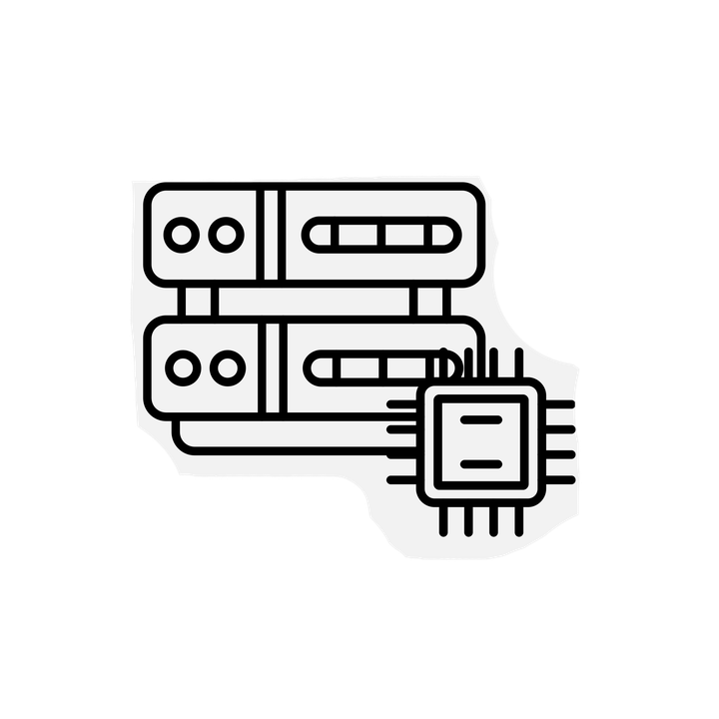
AI is distributing. Networks weren't designed for it.
Global WAN traffic is projected to increase by 300% to 700% by 2034, largely due to AI.
SP 2
SP 1
AI traffic could represent 30% of WAN traffic by 2034.
SP 3
By the end of 2026, inference will account for approximately 67% of all AI compute.
It’s beautiful chaos. Someone has to connect it.
Notes:
Networks are changing shape.
AI training was centralized in massive data centers. Now inference is distributing — to micro data centers, containerized facilities, and edge locations chasing power and proximity to users.
These sites are appearing across multiple providers, in locations where network infrastructure wasn't designed for this type of workload.
Customers need fast, reliable, private connectivity to GPU clusters, AI factories, cloud storage, and SaaS — often across multiple SPs, over different transport types.
There's no easy or consistent way to enforce SLAs across that patchwork.
Training Scenario
One customer needs to connectivity to a training cluster and their cloud storage. Expensive to bring their traffic from the cloud to the training facility over public IP.
Distributed Inference Scenario
Another customer has 3 sites and needs connectivity to 3 local GPU clusters. Between these sites sits 3 different service providers. Managing those relationships to onboard customers is complex, manual and slow.
SP Scenario
SPs are getting new requests. Arvig (regional fiber operator is getting requests for 400G DIA. SaaS/Storage need to be connected with lower latency than ever before.
Underutilized Fiber could be the connectivity layer for distributed AI, but often just pipes and capacity is hidden and static, not visibility and programmable.
Sources
WAN Traffic Growth (300%–700%) & AI Share (30%) by 2034: Nokia Global Network Traffic Report https://www.nokia.com/artificial-intelligence/explainer-network-traffic-is-fundamentally-changing-in-the-ai-supercycle/
Inference = ~67% of All AI Compute by End of 2026: Deloitte 2026 Technology, Media & Telecommunications Predictions https://www.deloitte.com/us/en/insights/industry/technology/technology-media-and-telecom-predictions/2026/compute-power-ai.html

Slide 18
Connecting Distributed AI is Hard
AI workloads are no longer in one location
DC-A
DC-C
But connectivity between them is inconsistent
SP 2
Modern AI infrastructure includes:
Multiple inference clusters
Distributed GPU locations
Geographically separated data centers
Clusters are connected through:
Different fiber providers
Public internet routes
Indirect carrier paths
SP 1
Internet
Clusters must exchange:
Embeddings,
Model updates,
Inference results, and storage access.
This creates:
Unpredictable latency
Inefficient routes
Lack of control
Limited visibility
DC-B
Exchange
DC-D
The network is the bottleneck
Notes:
This diagram makes the problem outlined in Slide 16 more concrete.

Slide 19
Current Solutions Create More Complexity
Option 1 – Internet + DIA.
Option 2 – Private Fiber Mesh
DC-A
DC-C
ISP1
Internet
ISP2
DC-B
DC-D
Unpredictable routing
No latency guarantees
Limited visibility
Security concerns
Complex IP routing (BGP, MPLS, overlays)
Expensive full mesh
Slow provisioning
Difficult to scale when new sites appear
Connectivity becomes harder as AI infrastructure grows
Notes:
Current options for connecting distributed AI are
Using the public internet or
Building a private Fiber Mesh
Both come with challenges that create more complexity, especially as you scale.

Slide 20
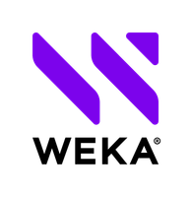

What if connectivity was this simple?
Cloud On-Ramps
MSPs & DCs
Private connectivity across any network. Provisioned in minutes without routing complexity.
Your Distributed
AI Factories
Marketplace
SaaS + AI + Storage
Enterprises
Programmable private paths — Instant network fabric
Distributed sites connected instantly, over any transport.
Predictable performance across network boundaries.
End-to-end insights across partner networks, fabrics, and clouds.
Automated
Programmable
Visible
Notes:
What if you could deploy a new GPU cluster and have private connectivity to every other site provisioned the same day?
What if you could offer customers an instant on ramp to your GPU cluster?
What if you could connect customers to clouds, storage, and SaaS applications via private paths?
All with predictable performance and end to end visibility.
Automated — distributed sites connected over any transport, instantly
Programmable — predictable performance, not best-effort
Visible — end-to-end insights across carrier networks

Slide 21
AI networks should behave like a fabric
AI clusters should not deal with routing complexities.
They should simply connect to form an instant network fabric.
Notes:
AI clusters shouldn't have to negotiate routing complexity. They should simply connect the way servers connect inside a data center, but across any geography, any transport.
This is already how hyperscalers operate internally. AWS and Azure run Ethernet inside their networks because of its simplicity. NVIDIA is moving from Infiniband to Ethernet for the same reason. MaiaEdge brings that fabric model to the WAN.

Slide 22
Distributed AI Infrastructure connected instantly
5G, DIA, Wave,
Satellite
Instant Private Fabric
Deploy a device at each DC
Connect over any available transport
Provision connectivity instantly
21 © 2026 MaiaEdge
Notes:
The how-it-works slide.
Three steps:
Deploy a MaiaEdge PBC at each data center or inference site
Connect over whatever transport is available — 5G, DIA, Wave, Satellite
Provision connectivity instantly.
The result is an instant private fabric between your distributed AI sites.
No routing protocols. No manual configuration. No dependency on a single transport type.

Slide 23
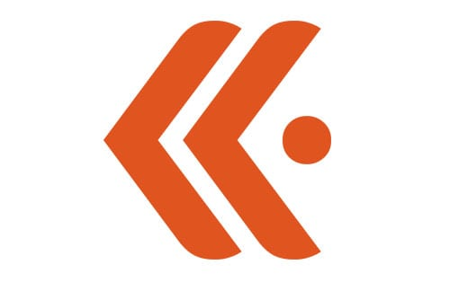
Extend Your AI Fabric
5G, DIA, Wave,
Satcom
MSPs & DCs
Cloud On-Ramps
Enterprises
Marketplace
SaaS + AI + Storage
Instant Private Fabric
Instant GPU On-Ramp
Speed customer onboarding
Cloud Connectivity
Reduce cloud egress fees
Ecosystem Access
Reach partners and services
22 © 2026 MaiaEdge
Notes:
Instant GPU On-Ramp - Just as cloud on ramps transformed how enterprises connect to major cloud platforms, the rise of distributed AI is driving the need for a similar GPU on ramp to connect customers to GPU clusters. You can create an instant private on-ramp to your GPUs with deterministic performance.
Cloud Connectivity – Lower egress costs by setting up direct connect to clouds (9c/GB via internet and 2c/GB via direct
connect).
Ecosystem - tap into a broader ecosystem to connect your customers to other services.

Slide 24
The Infrastructure
Push-button easy and hardwire simple
Path Border Controller (PBC)
Path Computation Engine (PCE)
Private Ethernet paths
End-to-end encryption
Merges Layer 2 and 3 functionality
Dual 100 Gbps Interfaces
No routing protocols
Carrier-Neutral NNI Engine
Cloud-Native Orchestration
Real-time Path Computation
Multi-Tenant
Hop-by-hop visibility
Notes:
MaiaEdge has two components working together.
First, the Path Border Controller — a dual-100 Gig appliance that merges Layer 2 and 3 into one stateless edge. It’s hardware-optimized for throughput, encryption, and zero-touch provisioning.
Second, the Path Computation Engine — our cloud-native orchestration layer. It computes deterministic paths in real time, automates NNIs, and allows carriers to federate while remaining fully sovereign.
(hand gesture)
Together they form a carrier-neutral NNI engine. No MPLS upgrades. No SRv6. Just plug it in, register it, and deliver private paths instantly — over fiber or DIA.
That’s instant private connectivity.
Plug and play – you don’t have to change your core network

Slide 25
The Infrastructure
Turnkey, plug-and- play switching.
Integrated switch for additional port density
Designed exclusively for the PBC, the integrated switch delivers high-density ports with zero operational overhead.
Port Extender
Interfaces: 48 SFP28 10GbE/25GbE ports, 8 QSFP28
100GbE ports, Rear CPU/BMC shared Ethernet
Management (RJ45) and Serial Console (RJ45) ports,
Latency: Less than 500ns port to port
25 © 2026 MaiaEdge
Notes:
The Port Extender is the integrated switch that sits alongside the PBC to add port density at customer sites. It's not a separate management headache, all managed from the same cloud-native dashboard.

Slide 26
26 © 2026 MaiaEdge
Notes:
For AI infrastructure, path visibility is directly tied to workload performance. When a model inference is slow, the first question is always "is it the network?" With MaiaEdge, you have the answer before the question is asked — hop-by-hop telemetry across the full path, even across partner networks.
One of the things that's fundamentally different about MaiaEdge is that visibility doesn't stop at your network edge. You can see every hop across your network, across partner networks, through a NaaS fabric, and all the way to the cloud on-ramp. No other platform does that today.
When performance degrades, your team knows exactly where the problem is.

Slide 27
Multi-Tenancy: MSP & Customer View
Network operator view
Customer view (multi-tenancy)
Full topology view
Link capacity & utilization
Complete path health & SLA
Customer self-provisioning
Monitoring and policy control
Private path visibility
27 © 2026 MaiaEdge
Notes:
The operator view gives full topology, path health, and utilization across every connected cluster and site. For SPs serving multiple AI customers, the multi-tenancy model means complete isolation between customers from a single deployment.
The customer portal lets AI infrastructure operators self-provision new site connectivity and monitor performance without filing a support ticket.
APIs available for operators who have their own dashboards but want to pull in MaiaEdge path data.

Slide 28
Instant Private Fabric for Distributed AI Infrastructure
Deterministic performance
No routing complexity
Sovereign Routing
Multi-tenant
End-to-end visibility
One PBC. Instant private connectivity, anywhere.
Ethernet over DIA or wave. Live in minutes, not years.
Notes:
Use this as the close for the AI section. The five bullets are the summary of what MaiaEdge delivers for AI infrastructure:
Deterministic performance — no best-effort routing, guaranteed paths
No routing complexity — clusters connect without BGP, MPLS, or overlay stacks
Sovereign Routing — traffic stays private, never touches the public internet
Multi-tenant — serve multiple AI customers from one platform
End-to-end visibility — every hop, across every network
One PBC at each site. Ethernet over DIA or wave. Live in minutes.
If it's the right moment: "Which of these five matters most to what you're trying to solve?"

Slide 29
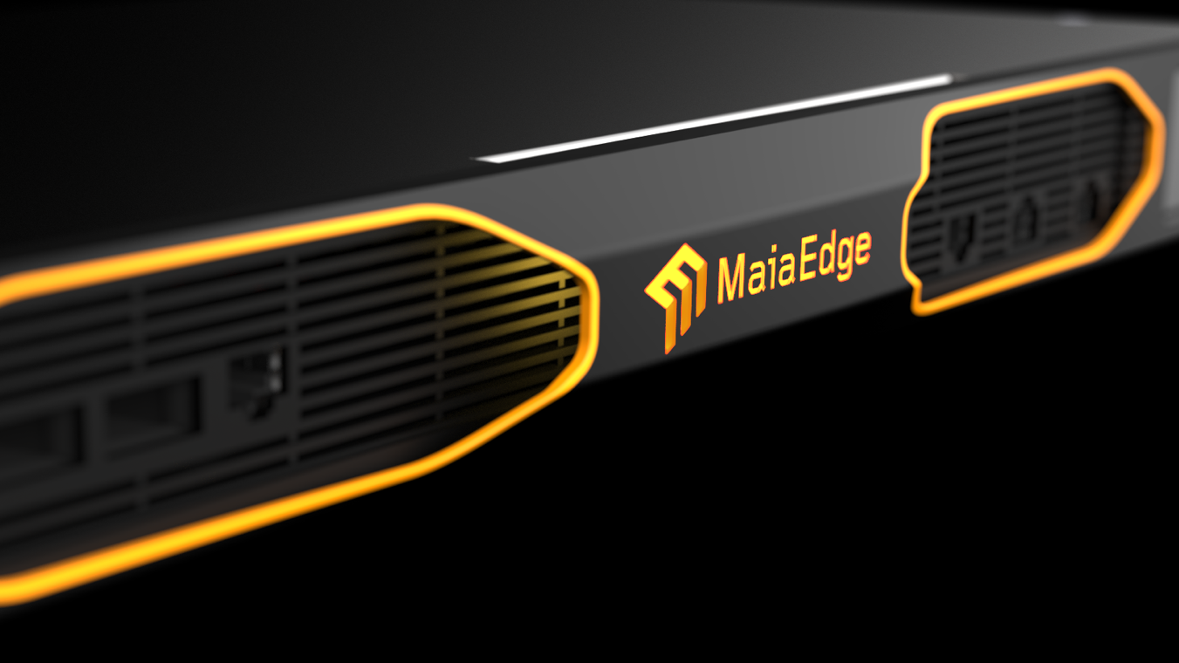
© 2026 MaiaEdge
Notes:
Here it is—the hero. The MaiaEdge appliance is the single install that turns any on‑net building into an on‑demand edge. Once it’s in, services stop being projects and start being products—ordered, priced, and turned up in minutes, not weeks.
One device, many private paths. After the initial fiber and device install, every new circuit is software‑defined and API‑driven—no routing stacks to manage, no repeat truck rolls.

Slide 30
Fabric of Fabrics
DATA CENTERS AND COLOCATION PROVIDERS
Instant DCI, Virtual MMRs, Connectivity Marketplace
May 2026
Notes:
How long does it take to provision cross-connects?
• Do customers ask for cloud on-ramp or inter-DC connectivity?
• Do you have a service fabric like Equinox with market place. How easy is it to manage ?

Slide 31
Instant Private Connectivity, Anywhere.
OUR VISION
Programmable private paths — instant network fabric.
Notes:
Our Vision: Instant Private Connectivity, Anywhere
From under-utilized fiber — to instant private paths — ready to sell, ready to scale. That’s our vision.
For operators, this means: no waiting on builds, no new routing protocols, and instant monetization of the network you already own. For end customers, it’s the first time private connectivity feels like cloud — on-demand, API-driven, consumption-based.
Technical simplicity is economic opportunity.
When connecting sites becomes push-button easy, fiber finally behaves like a digital asset, not real estate.

Slide 32
3 Decades of Connecting Networks
The Team
Acme Packet
Invented Session Border Controller. Founded in 2000. Acquired by Oracle in 2013.
Cisco
Led MPLS Architecture team.
128 Technology
Invented Secure Vector Routing. Founded in 2014. Acquired by Juniper Networks in 2020.
ABILASH MENON
CEO & Co-Founder
TIM ZIEMER
CRO & Co-Founder
ANDY ORY
Executive Chairman
PATRICK MELAMPY
CFO & Board Member
Juniper Networks
Integrated SD-WAN technology as the routing engine for Mist AI.
Cisco, 128 Technology, Juniper
Acme Packet, Oracle
128 Technology, Juniper
Acme Packet, Oracle
128 Technology, Juniper
Acme Packet, Oracle
128 Technology, Juniper
Notes:
Our leadership team has been doing this for decades. Our mission across mulitiple companies has been the same – simplifying network connectivity.
Acme Packet — Voice was fragmented across incompatible networks. The SBC became the standard bridging layer. It's still running in 90% of global carriers today.
Cisco – transformational in MPLS architecture, our CEO led that team
128 Technology — IP routing was expensive, rigid, and hard to manage at scale. Secure Vector Routing (SD-WAN) simplified it. 128T was Juniper's largest acquisition.
Juniper and Mist Systems – AIOps
MaiaEdge — Private Ethernet connectivity is fragmented, static, and manually provisioned. Same problem, next evolution in networking.
Timeline
Andy and Pat Founded Acme Packet in 2000
Invested the Session Border Controller, for connecting VoIP, Technology today is used by 90% of the global 100 Carriers and largest Enterprises
Went Public in 2006 and was acquired by Oracle in 2013 for $2B
Andy and Pat founded 128 Technology 2014
Acquired by Juniper in 2020 as the routing engine for Mist in the AI-Driven enterprise business unit. Juniper’s largest acquisition.
Same team started MaiaEdge in 2024.
People have come out of retirement for MaiaEdge because they believe in the leadership and the product.

Slide 33
Traditional Interconnection
Manual Every cross-connect requires engineering effort and configuration overhead.
No On-Ramp Cloud connectivity is complex to provision. NaaS fabrics take revenue and a share of customer ownership.
No Marketplace Providing a fabric-like experience requires years of development and capital.
Tenant
4
Tenant
1
Tenant
2
Tenant
5
Meet-me Room
Tenant
3
Tenant
6
33 © 2026 MaiaEdge
Notes:
Traditional interconnection methods are bottleneck.
Manual — Cross-connects are still largely an engineering task. Every new connection requires configuration work, physical coordination, and time. At scale this becomes a staffing problem and a speed-to-revenue problem.
No On-Ramp — Tenants increasingly expect cloud connectivity as a native service. The options today are: build it yourself (expensive and complex) or route through NaaS fabrics like Equinix or Megaport, which take a share of the revenue and own part of the customer relationship.
No Marketplace — An Equinix-style connectivity marketplace is a real competitive differentiator. It's also prohibitively expensive to build from scratch. Most colo operators don't have the engineering resources or capital to replicate it.

Slide 34
What if connectivity was this simple?
Cloud On-Ramps
DCs
Your Network
Private connectivity across any network. Provisioned in minutes without routing complexity.
Tenants
Marketplace
SaaS + AI + Storage
Programmable private paths — Instant network fabric
Cross connects and private paths established in minutes.
Deterministic connectivity across network boundaries.
End-to-end insights across partner networks, fabrics, and clouds.
Automated
Programmable
Visible
Notes:
What if a tenant could request a cross-connect and have it live in minutes — no work order, no engineering queue?
What if you could offer cloud on-ramps, AI infrastructure access, and SaaS connectivity as native services from your facility — without ceding the customer relationship to a third-party fabric?
What if you could give tenants a marketplace that looks and feels like what the largest exchanges offer, without years of development?

Slide 35
Instant Services Fabric
Automated Spin up cross-connects and provision private Ethernet paths. No routing complexity.
Self-Service Portal Tenants can self-provision connectivity services through your white-label portal.
Marketplace Extend reach through partnerships to deliver your own connectivity marketplace.
Tenant
1
Tenant
2
Tenant
3
Virtual Meet-me Room
Marketplace
SaaS + AI + Storage
Partner DCs
Cloud On-Ramps
35 © 2026 MaiaEdge
Notes:
Automated — Cross-connects and private Ethernet paths provisioned in minutes. No routing complexity, no engineering queue. Physical infrastructure stays the same — what changes is how quickly it can be configured and turned up.
Self-Service Portal — Tenants can provision their own connectivity through a white-labeled portal under your brand. New connection, path monitoring, policy management — all self-serve.
Marketplace — Connect tenants to cloud on-ramps, SaaS services, AI infrastructure, and partner DCs through a marketplace you operate. You stay in the middle. You own the tenant, you own the revenue.

Slide 36
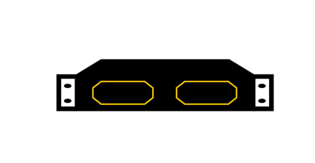
Extend Your Datacenter Instantly
DATACENTER A
DATACENTER B
Tenant 1
DIA
Fiber
Tenant 2
Fabric
DCI
Deterministic performance across DCs
Extend Reach
One PBC anywhere, instant fabric extension
Visibility
See every network hop
35 © 2026 MaiaEdge
Notes:
Instantly connect your distributed data centers over DIA or wave.
Drop a PBC to instantly extend your reach – a new facility, a partner site, a remote PoP.
Instantly establish private Ethernet connectivity between two PBCs
See every network hop regardless of underlying transport.

Slide 37
The Infrastructure
Push-button easy and hardwire simple
Path Border Controller (PBC)
Path Computation Engine (PCE)
Private Ethernet paths
End-to-end encryption
Merges Layer 2 and 3 functionality
Dual 100 Gbps Interfaces
No routing protocols
Carrier-Neutral NNI Engine
Cloud-Native Orchestration
Real-time Path Computation
Multi-Tenant
Hop-by-hop visibility
Notes:
MaiaEdge has two components working together.
First, the Path Border Controller — a dual-100 Gig appliance that merges Layer 2 and 3 into one stateless edge. It’s hardware-optimized for throughput, encryption, and zero-touch provisioning.
Second, the Path Computation Engine — our cloud-native orchestration layer. It computes deterministic paths in real time, automates NNIs, and allows carriers to federate while remaining fully sovereign.
(hand gesture)
Together they form a carrier-neutral NNI engine. No MPLS upgrades. No SRv6. Just plug it in, register it, and deliver private paths instantly — over fiber or DIA.
That’s instant private connectivity.
Plug and play – you don’t have to change your core network

Slide 38
The Infrastructure
Turnkey, plug-and- play switching.
Integrated switch for additional port density
Designed exclusively for the PBC, the integrated switch delivers high-density ports with zero operational overhead.
Port Extender
Interfaces: 48 SFP28 10GbE/25GbE ports, 8 QSFP28
100GbE ports, Rear CPU/BMC shared Ethernet
Management (RJ45) and Serial Console (RJ45) ports,
Latency: Less than 500ns port to port
38 © 2026 MaiaEdge
Notes:
The Port Extender is the integrated switch that sits alongside the PBC to add port density at customer sites. It's not a separate management headache, all managed from the same cloud-native dashboard.

Slide 39
39 © 2026 MaiaEdge
Notes:
End to end visibility. From customer site, across partner network, through NaaS fabric, cloud on ramp, and into customer cloud profile (cloud profile would only be visible to the end user).

Slide 40
Multi-Tenancy: MSP & Customer View
Network operator view
Customer view (multi-tenancy)
Full topology view
Link capacity & utilization
Complete path health & SLA
Customer self-provisioning
Monitoring and policy control
Private path visibility
40 © 2026 MaiaEdge
Notes:
The operator view gives full topology, link utilization, and path health across every tenant circuit and DCI connection
The tenant portal is white-labeled under your brand. Tenants can self-provision connections and monitor their own paths performance. For colo operators looking to differentiate on experience, this is a direct answer to what the larger exchanges offer.
APIs available for operators who want to pull MaiaEdge path data into their own management platform.

Slide 41
Simplified Cloud Connectivity
Cloud On-Ramps
Cloud connectivity made easy.
May 2026
Notes:
This section can be used in any discussion. It outlines 3 easy routes for starting cloud on ramp services or simplifying existing ones.

Slide 42
Simplify Cloud Access
Unlock new revenue streams. Eliminate complex provisioning.
Notes:
Our Vision: Instant Private Connectivity, Anywhere
From under-utilized fiber — to instant private paths — ready to sell, ready to scale. That’s our vision.
For operators, this means: no waiting on builds, no new routing protocols, and instant monetization of the network you already own. For end customers, it’s the first time private connectivity feels like cloud — on-demand, API-driven, consumption-based.
(short pause)
Technical simplicity is economic opportunity.
When connecting sites becomes push-button easy, fiber finally behaves like a digital asset, not real estate.

Slide 43



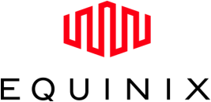
Cloud Access via Private Wavelength
Service Provider
Path Border Controller at your edge. Wave to Equinix PoP.
Automate cloud provisioning.
Notes:
Leading question: "Do you have an existing wave or fiber run into an Equinix PoP today?"
For SPs who already have a private wavelength to an Equinix PoP, a PBC at the edge connects over the existing wave to the Equinix PoP. Cloud provisioning is then automated through the PCE. No new physical infrastructure required — the wave is already there.
This is the simplest and fastest deployment path. If the prospect has a wave to Equinix today.

Slide 44
Cloud Access via DIA
Direct Internet Access
Service Provider
Path Border Controller at your edge and at Equinix PoP.
Instant cloud access over DIA.
Notes:
No private wavelength to Equinix – no problem.
PBC at the SP edge + PBC at an Equinix PoP. The two devices create a private Ethernet path over DIA — no dedicated fiber required.
This is the no-new-fiber option. Any provider with DIA can offer private cloud connectivity using infrastructure they already have.
Low barrier to entry for starting cloud on ramp services.

Slide 45
Cloud Access via Partnership
Direct Internet Access
Service Provider
Partner Provider
Federate with partner providers for cloud connectivity.
Leverage partners to expand reach.
Notes:
For providers who don't have their own connection to Equinix and don't want to establish one. They can partner with another provider.
Establish a private path from your PBC to theirs, instantly get access to cloud on-ramps through them.
This is the fastest path to offering cloud services for operators not ready to invest in their own exchange presence. It also creates a new business model: SPs who already have cloud access can monetize that by becoming a federation partner for others in the fabric.

Slide 46
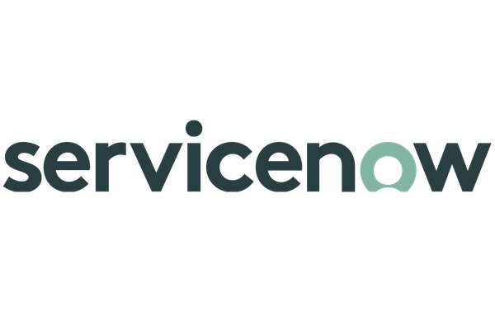
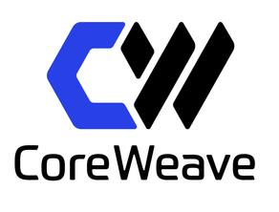

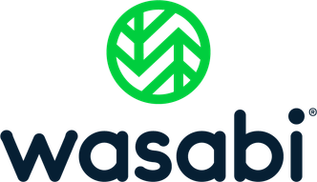
Expand Reach and Service Offerings
Service Provider
Offer any service in the Equinix fabric.
Deliver more than cloud connectivity.
Notes:
Once connected to the Equinix fabric, cloud is just the entry point. The full ecosystem includes SaaS providers, AI infrastructure, storage services, and interconnections to other carriers.
MaiaEdge gives the operator a programmable gateway into that ecosystem — and the ability to expose any of those services to their customers as private, branded offerings. Not just AWS and Azure, but whatever is in the fabric.
This is the longer-term play: the operator becomes a connectivity marketplace for their customers, not just a pipe.

Slide 47
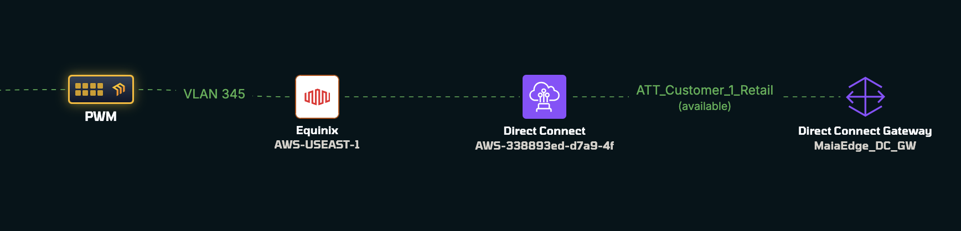
Cloud On-Ramp: Direct
If a data center already has direct:
Fiber connectivity to Equinix
Connectivity to Megaport
Access to other cloud exchanges
MaiaEdge can simply connect and expose cloud services
Cloud becomes another destination reachable instantly
© 2026 MaiaEdge
Notes:
Reiterating above + Visibility emphasized.
For operators with existing direct connections to Equinix, Megaport, or other cloud exchanges.
If the connection is already there, MaiaEdge makes it programmable. Drop a PBC, connect it to the existing fiber, and cloud becomes another destination provisioned through the PCE — instantly, like any other private path.
No new connectivity needed. The hard part is already done.
See every network hop, across fabric, cloud on ramp, and customer can see into cloud gateway

Slide 48
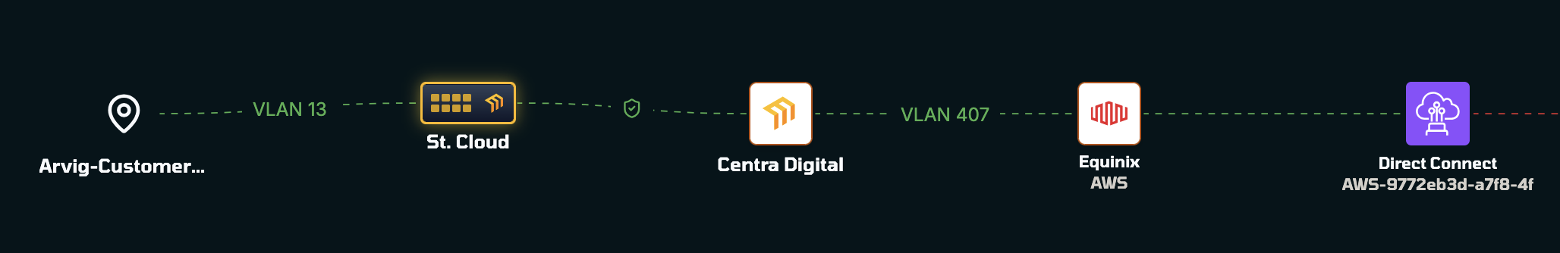
Cloud On-Ramp: Partners
If a site has DIA, it can still:
Connect to the network fabric
Reach a PBC deployed in Equinix
Access cloud services through partners
Reach cloud through MaiaEdge-enabled sites
Cloud becomes another destination reachable through partners
© 2026 MaiaEdge
Notes:
For sites that only have DIA — no direct connection to a cloud exchange.
Two options: connect over DIA to a MaiaEdge-deployed PBC at an Equinix PoP, or reach cloud through any other MaiaEdge-enabled site in the fabric that already has exchange access.
Either way, the site isn't locked out of cloud services because it lacks direct fiber. DIA is enough to participate in the fabric and reach cloud on-ramps through partners.

